Slide 1
WeCare i-Board
Team Hugo

Slide 2




Team
Anish
Maryam
Peter
Shivaani

Slide 3
Milestone 2 Targets
Functional Diagram
Hardware Drawing
Electronic Hardware Diagram
Bill of Materials

Slide 4
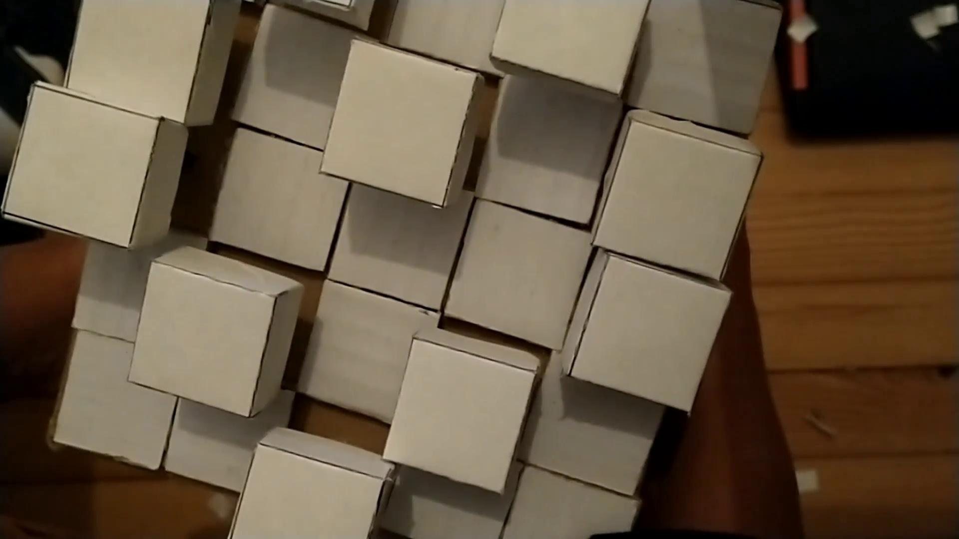
Overview

Slide 5
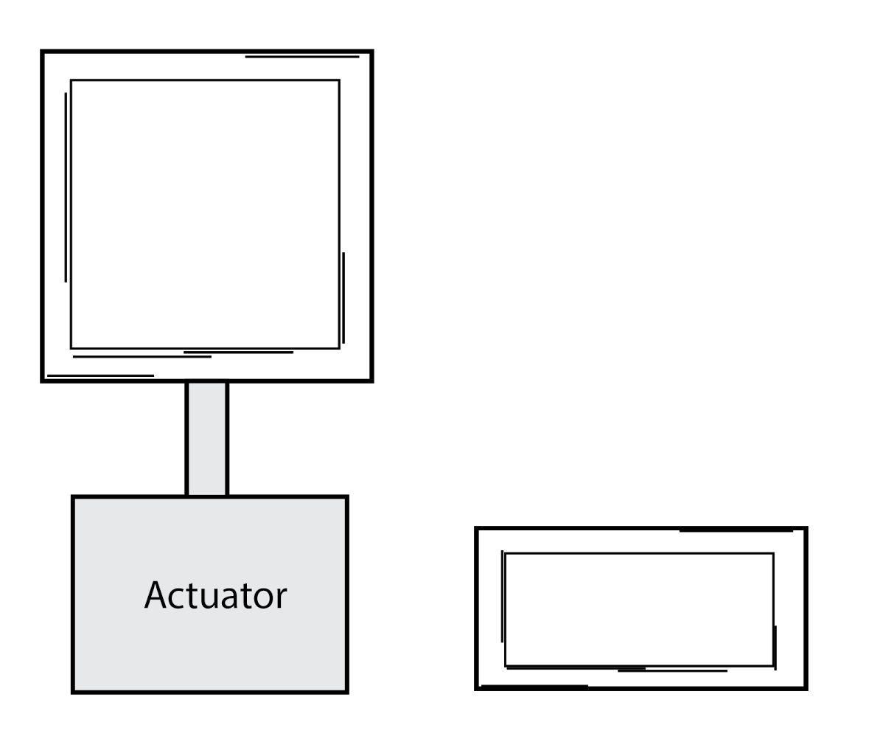
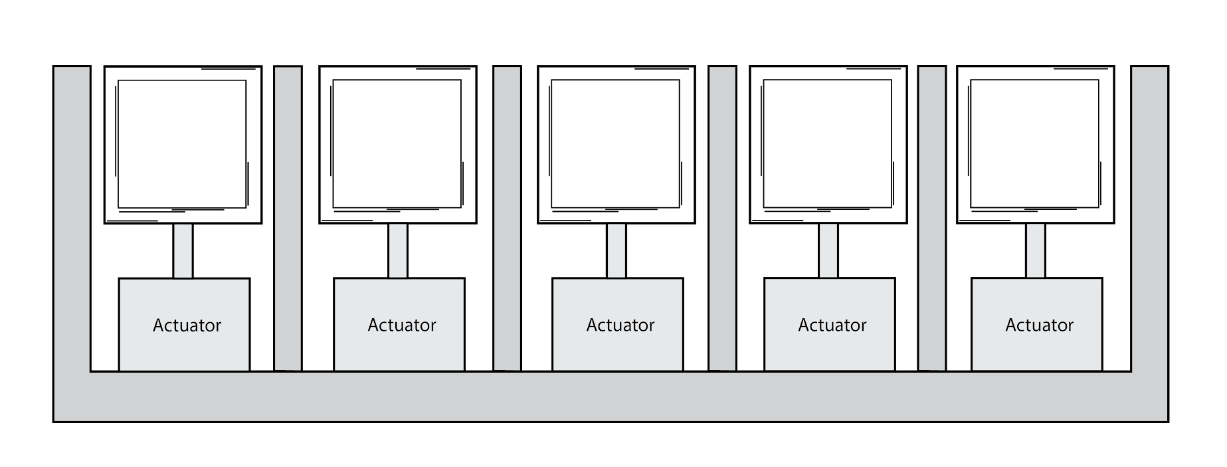
How It Works
25 ✖

Slide 6
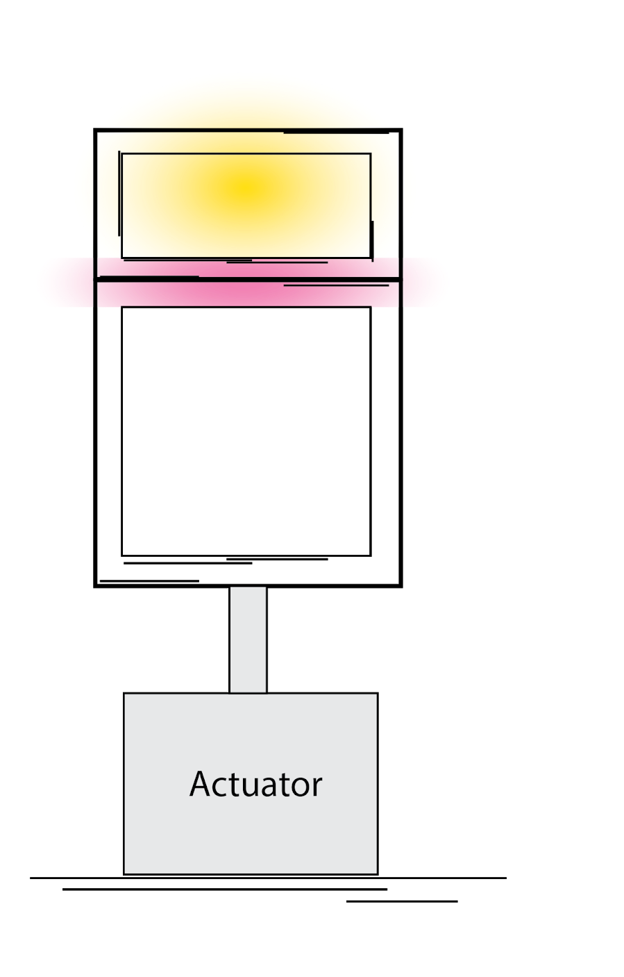
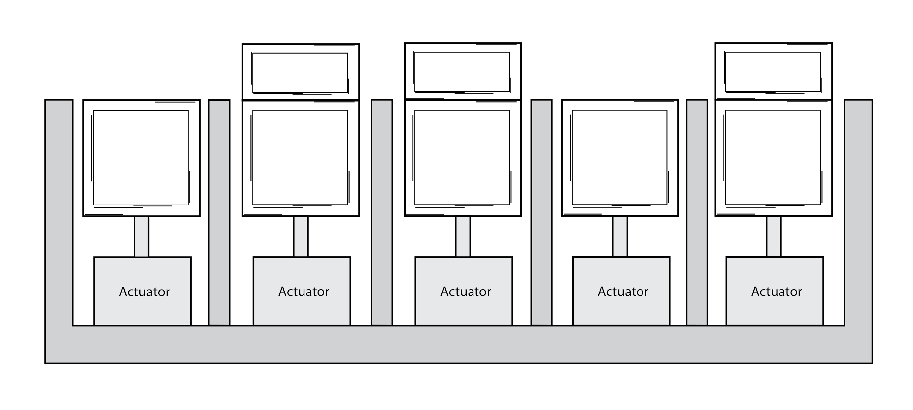

How It Works
User 1

Slide 7
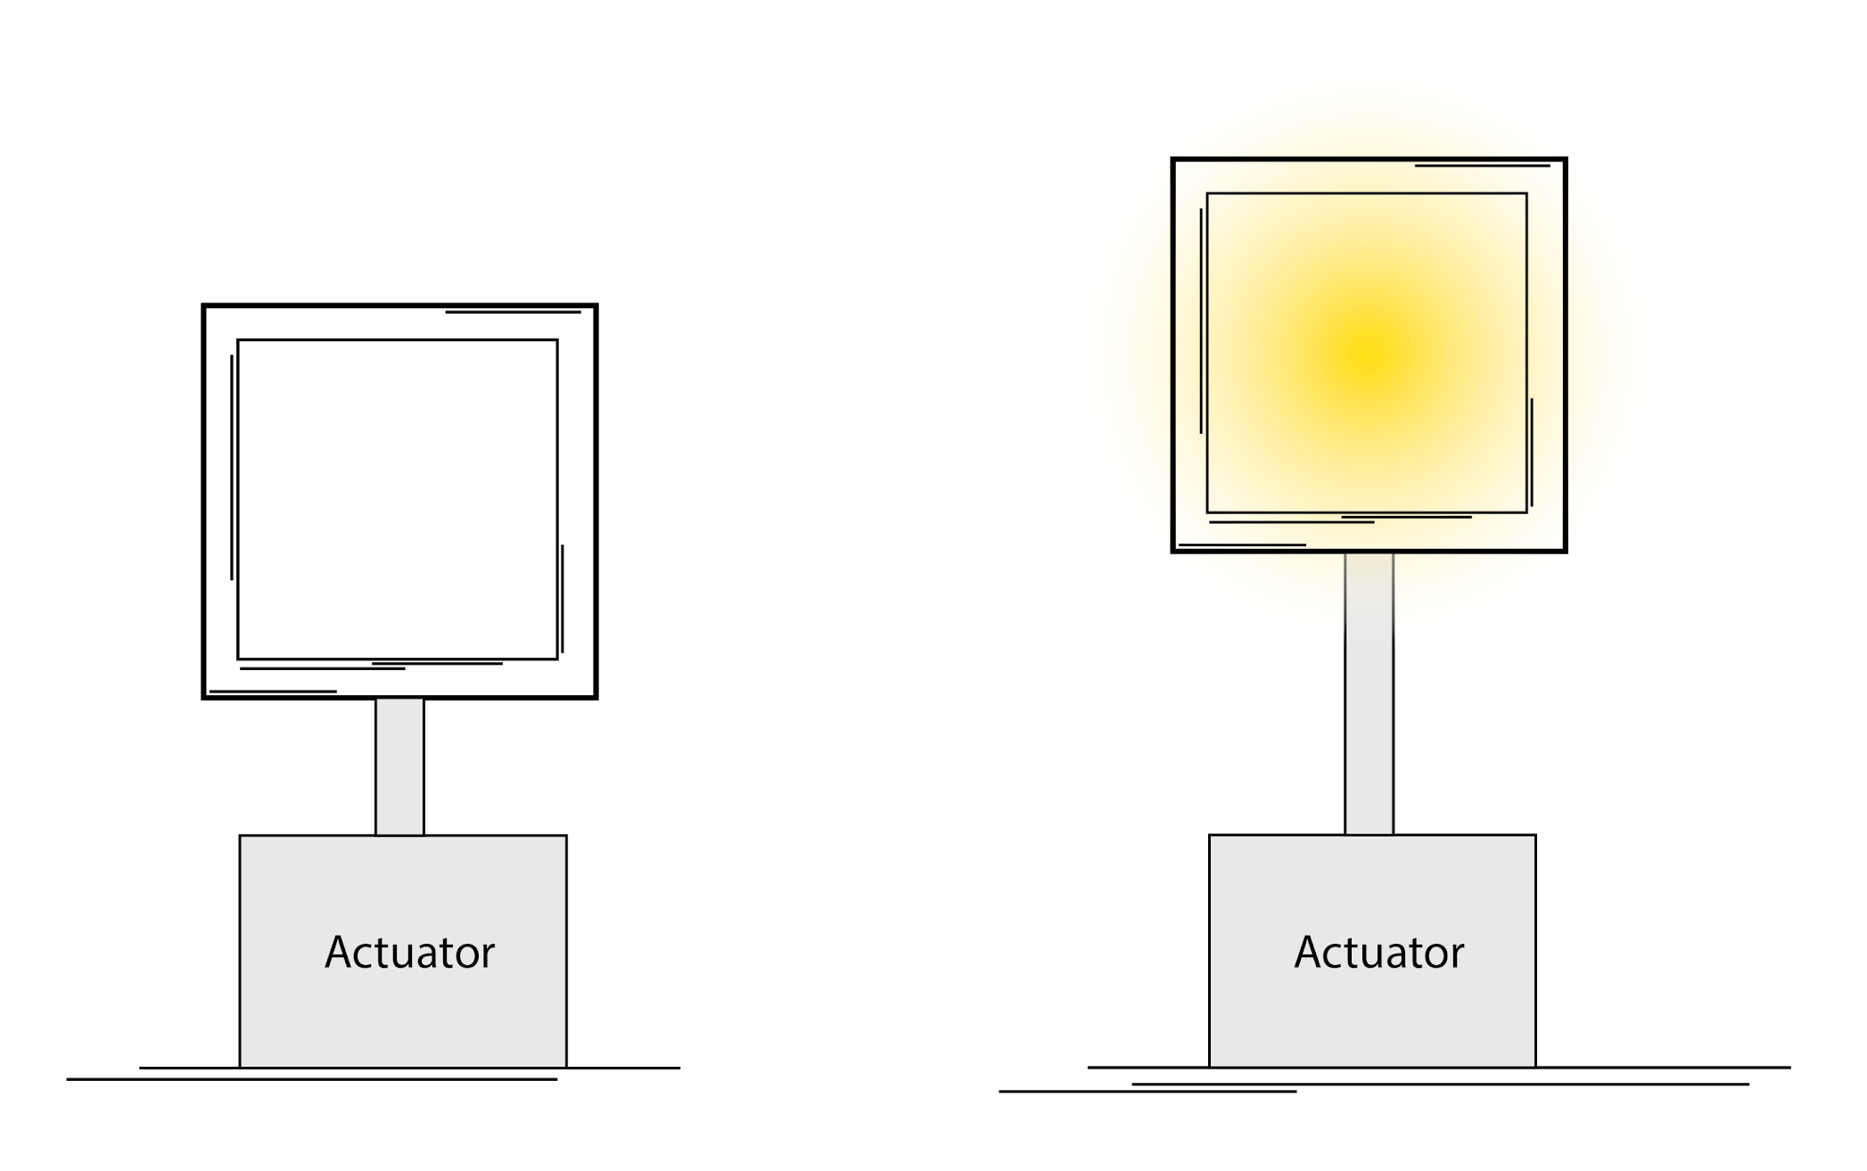
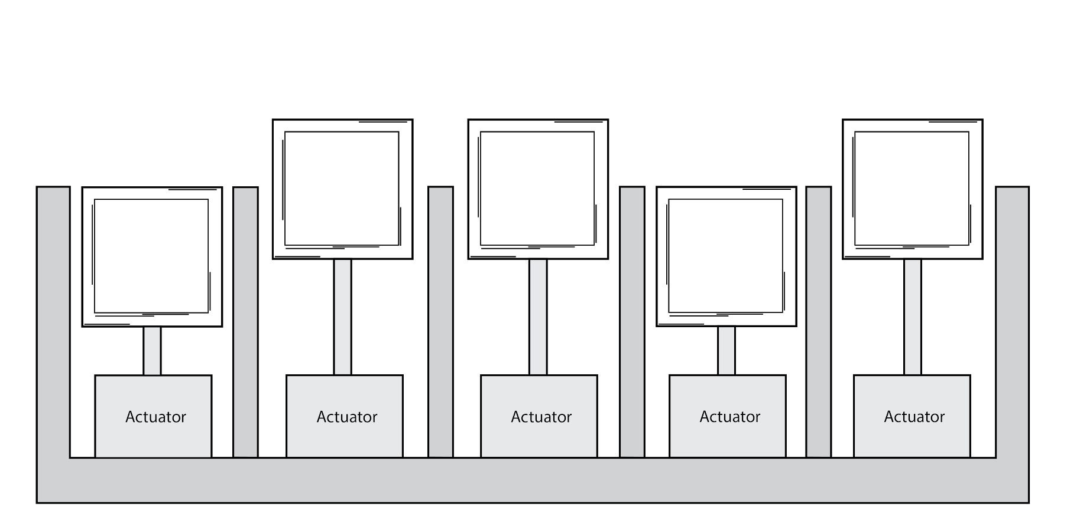

How It Works
User 2

Slide 8
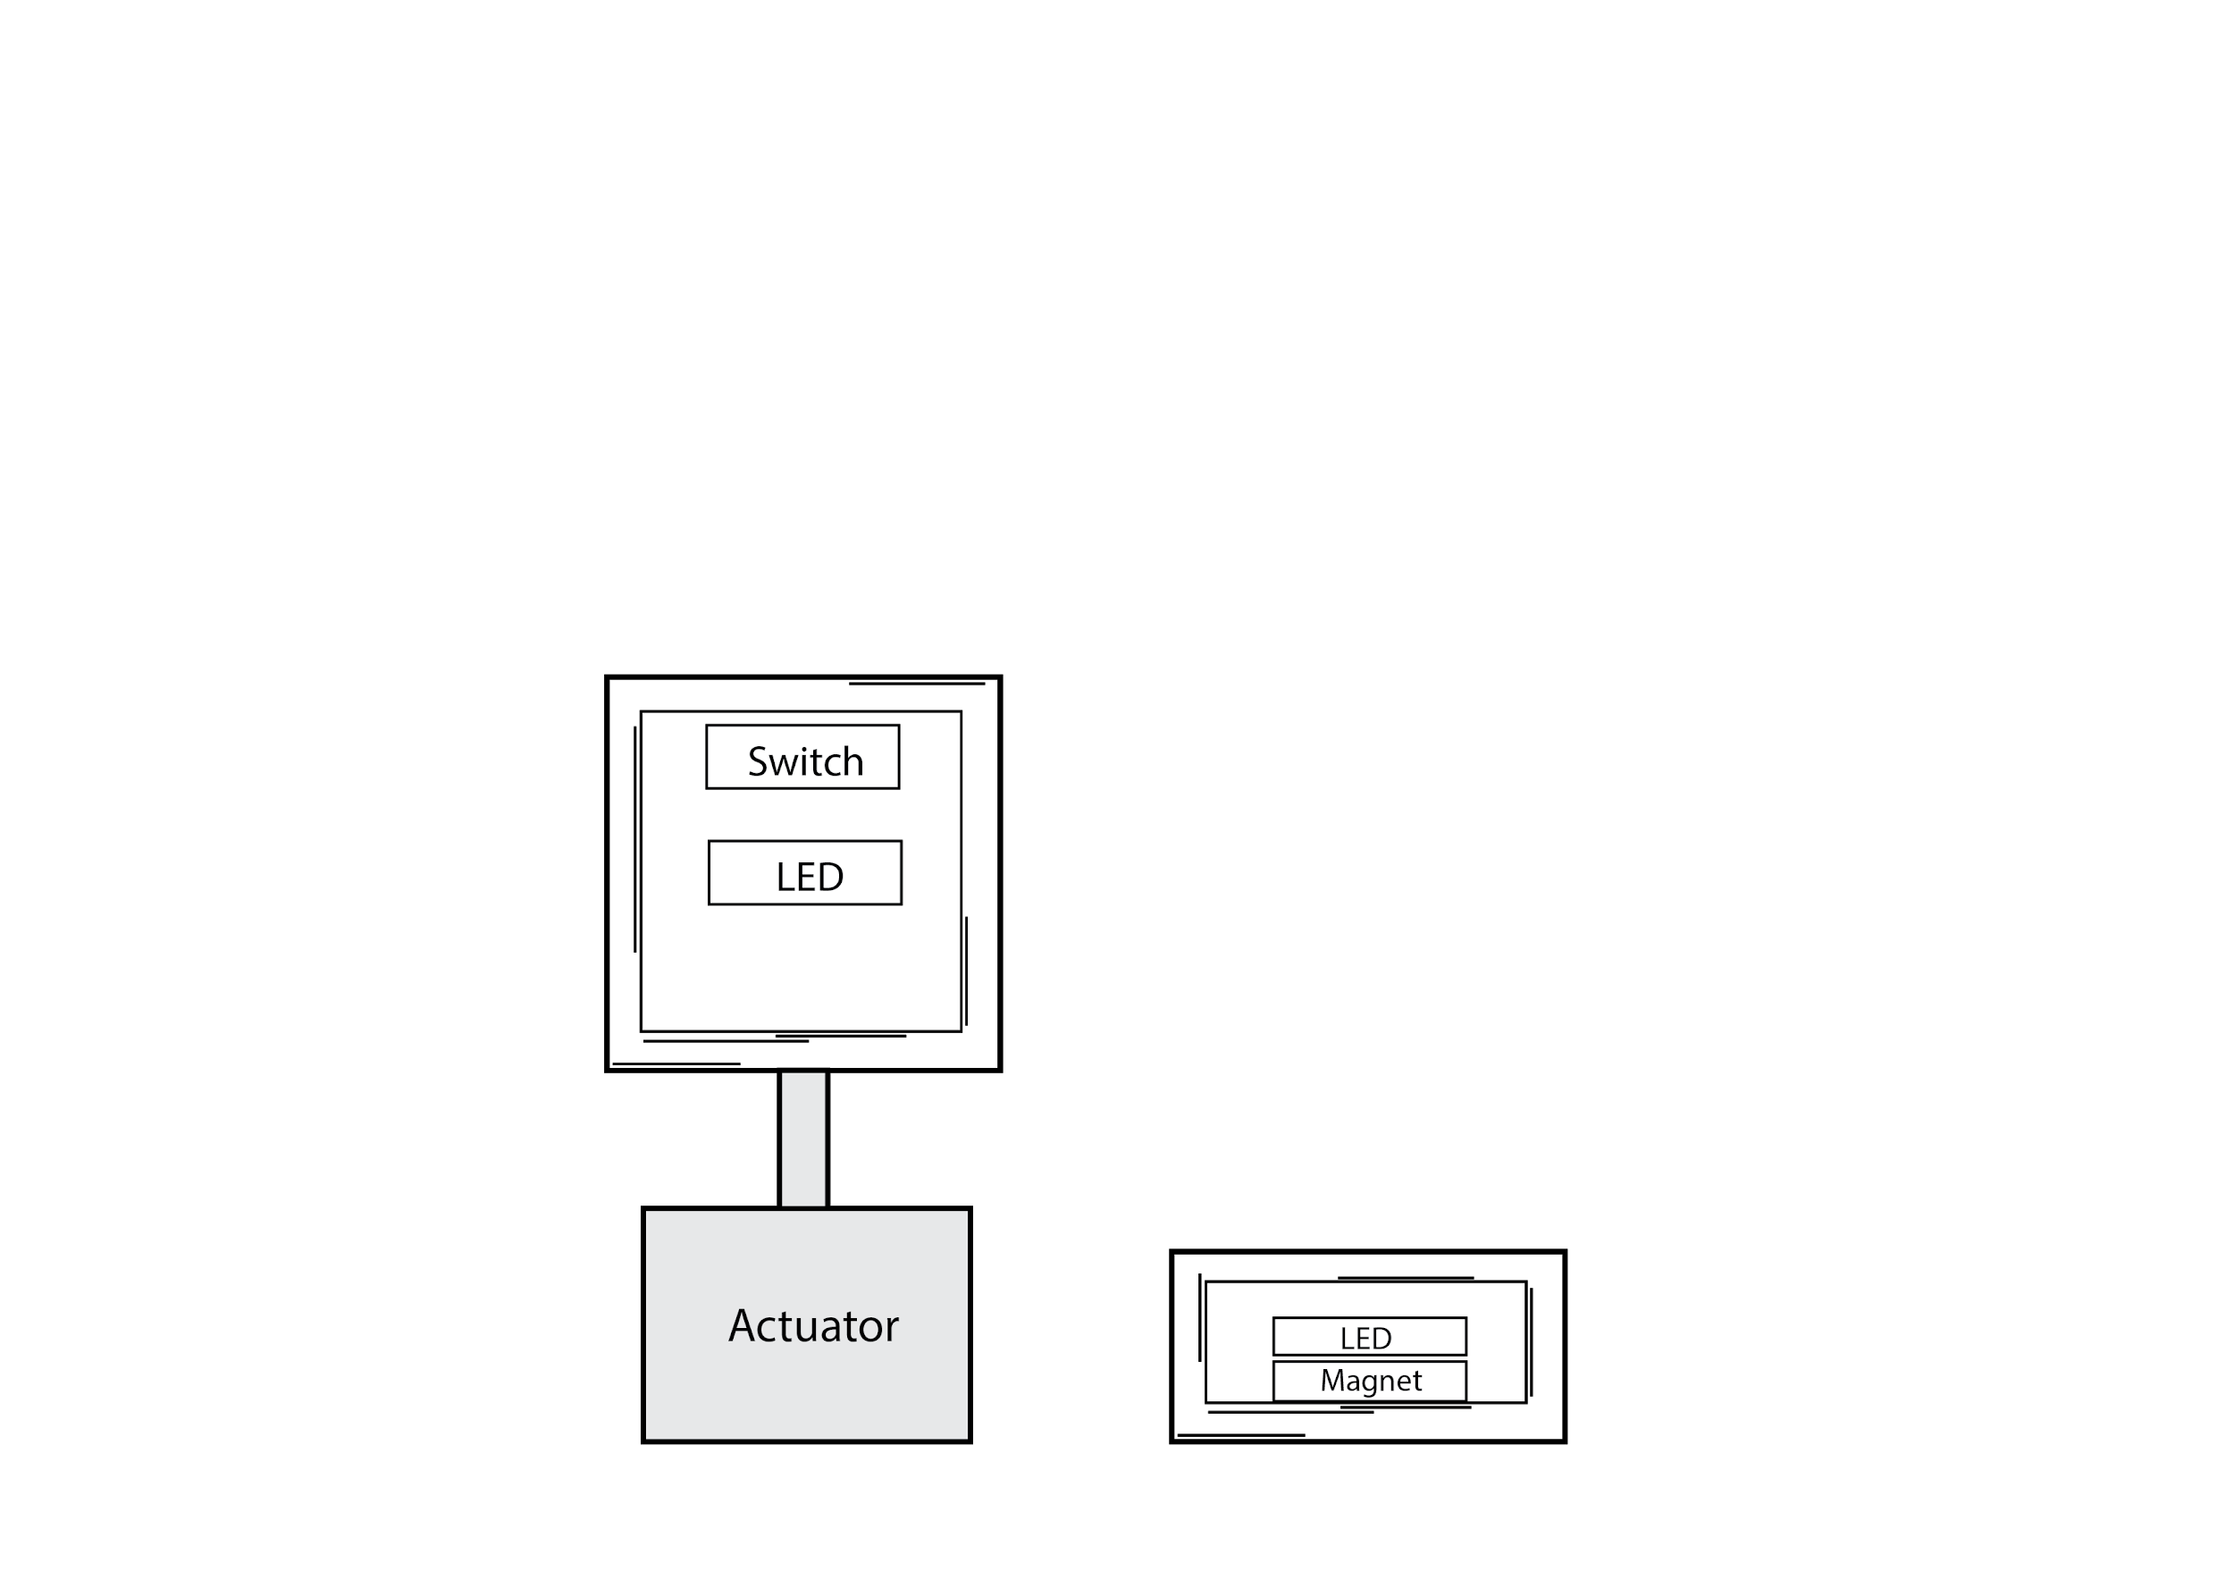
Details

Slide 9
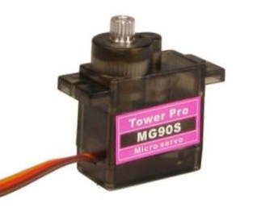
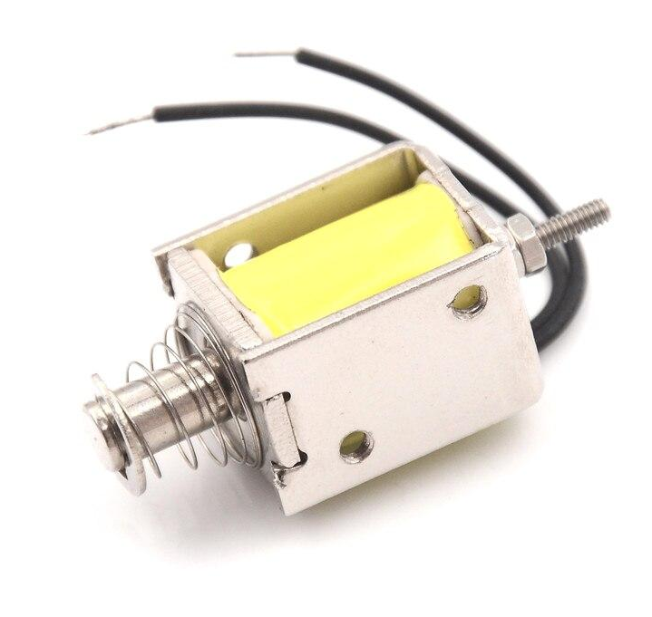
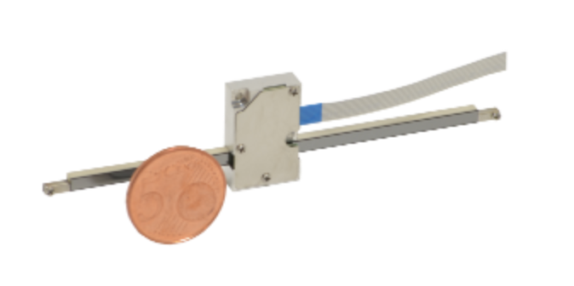
Actuator
Servo Motor
Solenoid
Linear Actuator

Slide 10
Actuator
Servo Motor
Solenoid
Linear Actuator

Slide 11
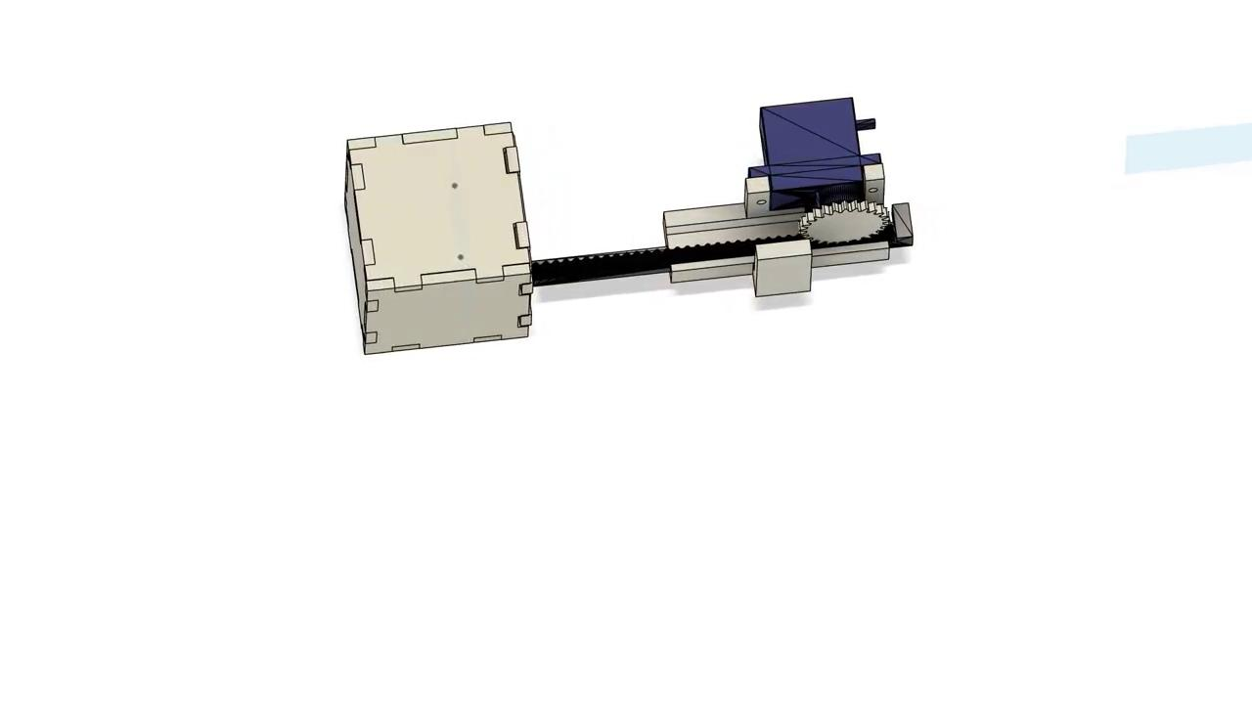
Actuator

Slide 12
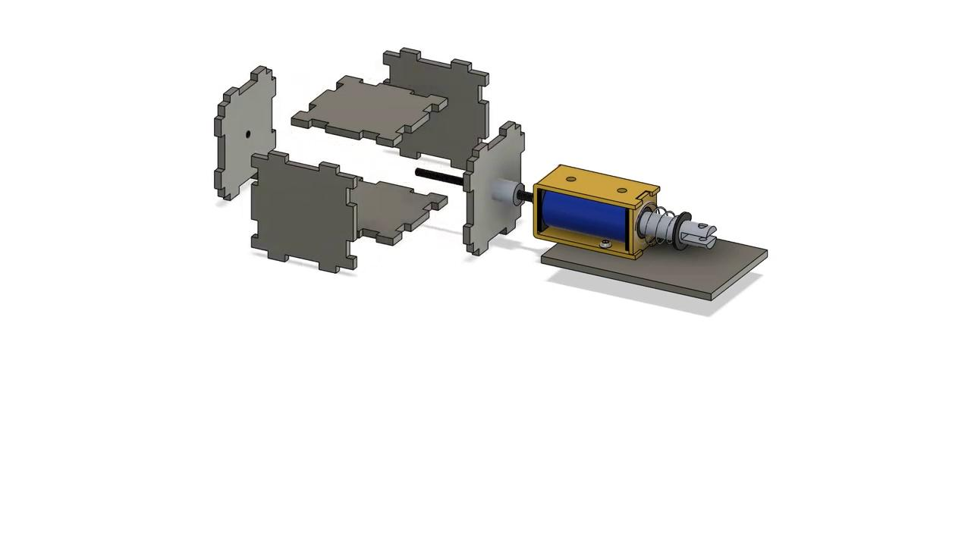
Actuator-Backup

Slide 13
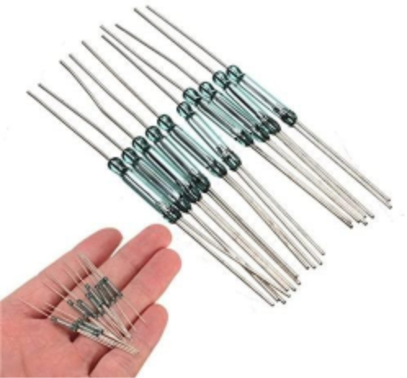

Detector/Sensor
Reed Switch + Magnet

Slide 14
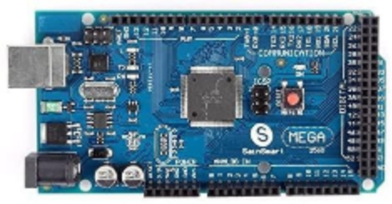
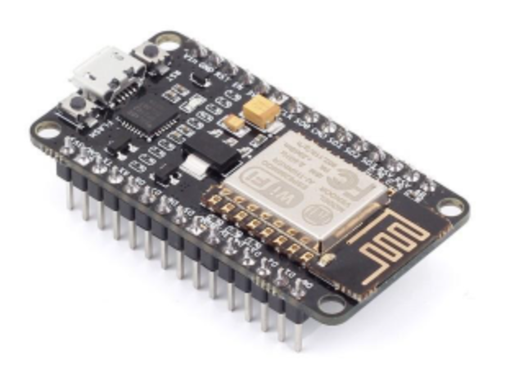
Processing and Communication
Data processing
Wireless communication between boards

Slide 15
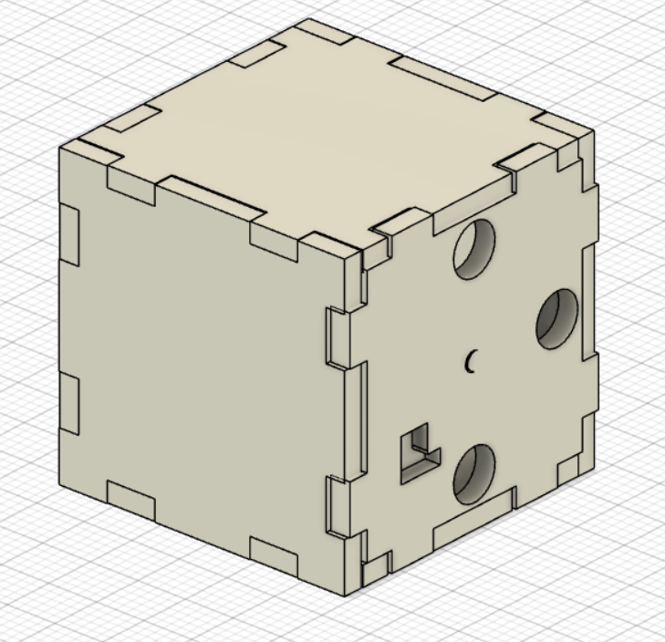
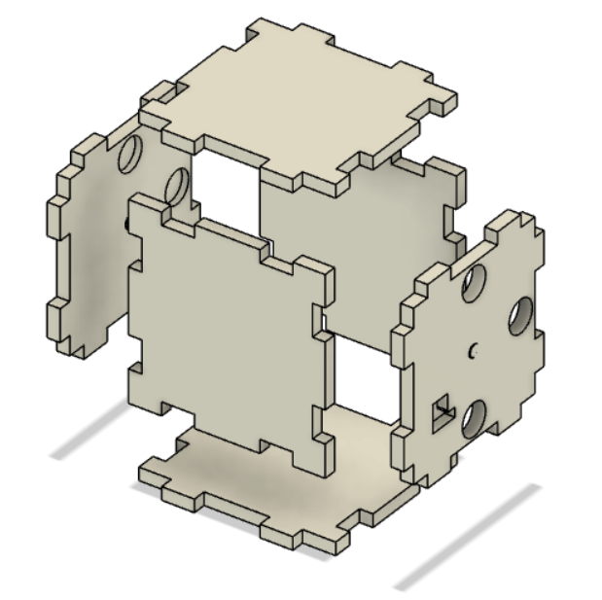
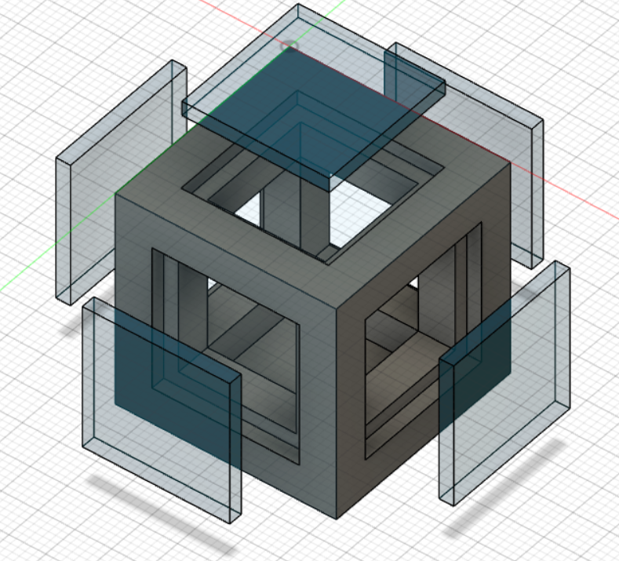
Cubes
Notes:
Discuss why the left one. Mention material.

Slide 16
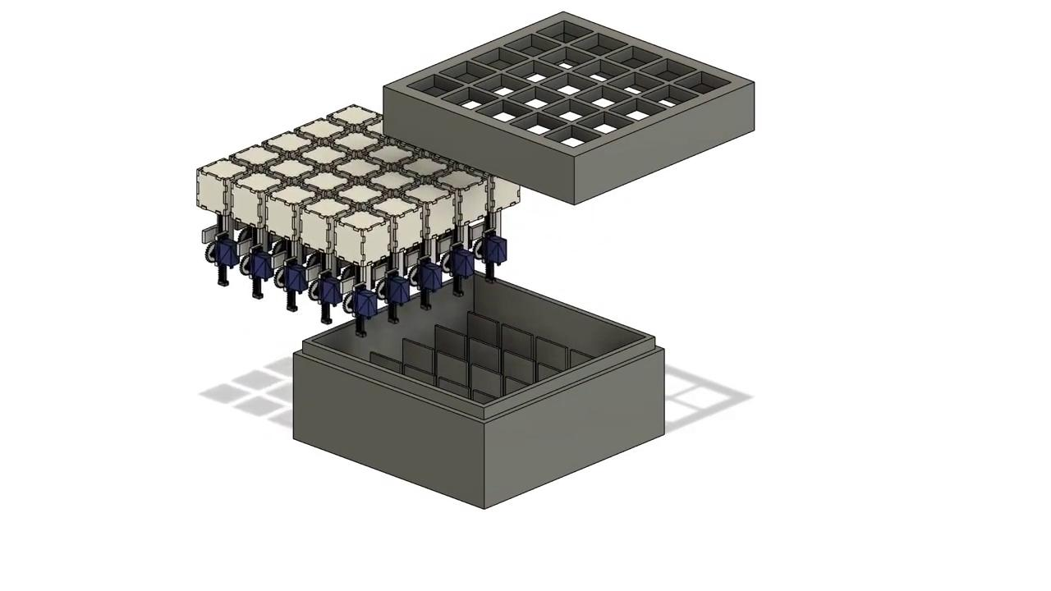
Hardware Model

Slide 17
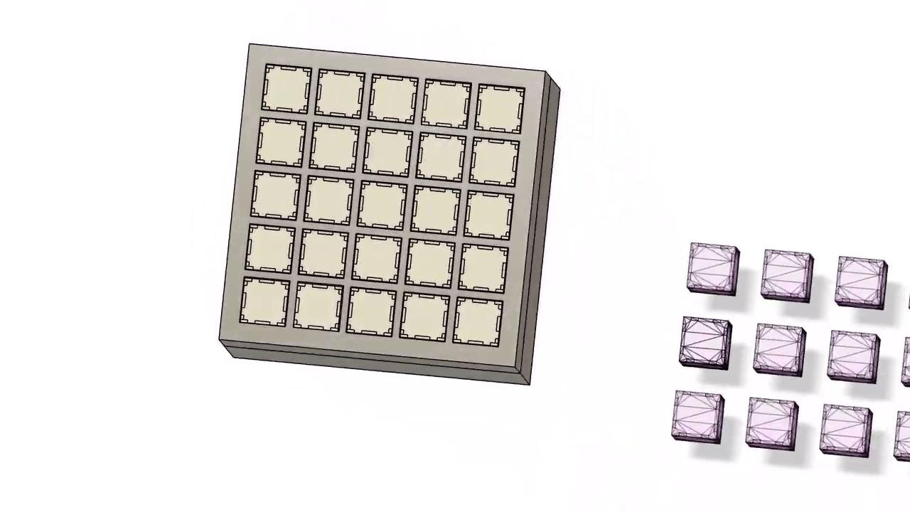
User 1 Board

Slide 18
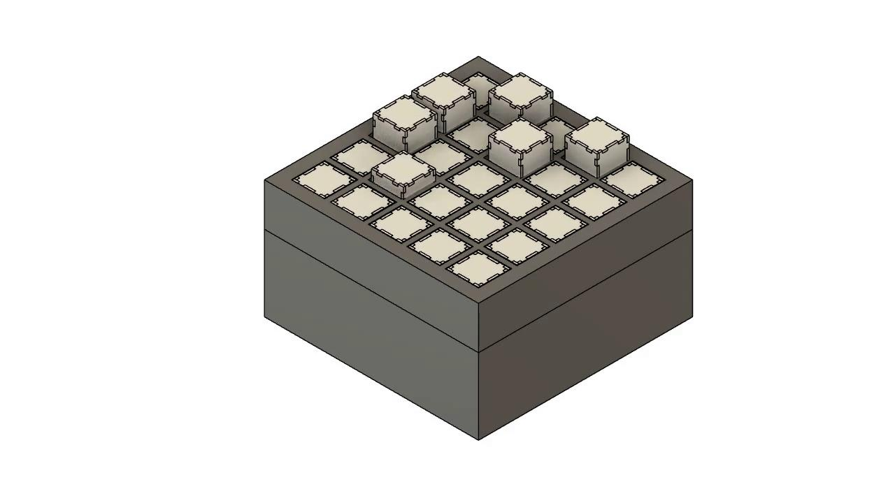
User 2 Board

Slide 19
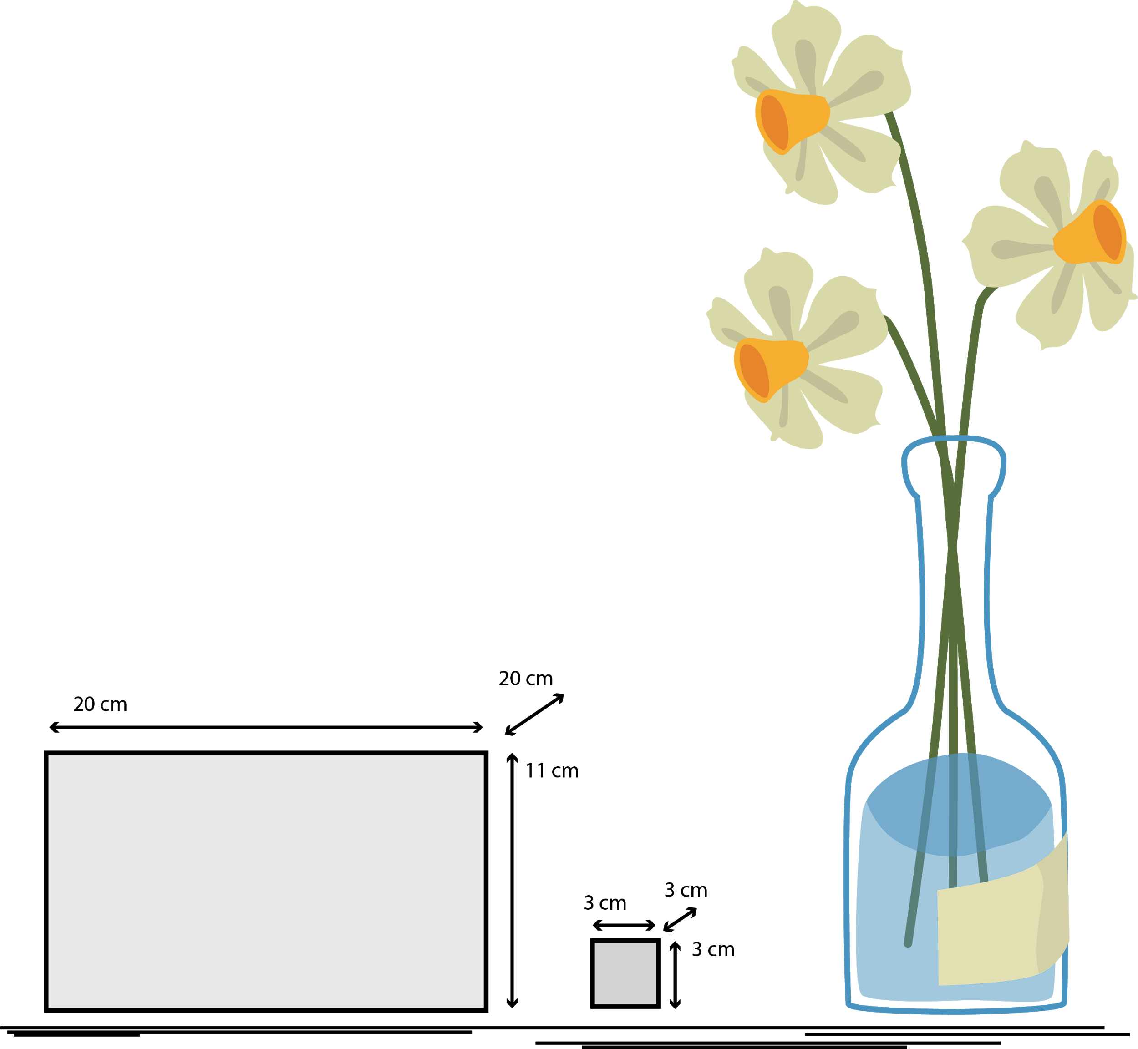
How It Looks Like

Slide 20
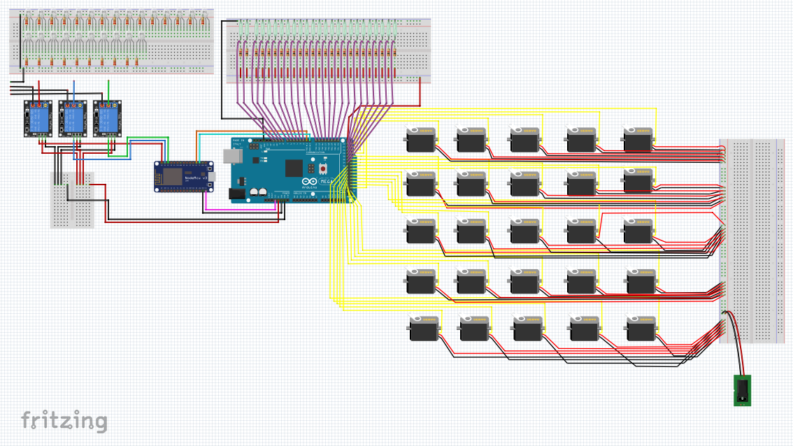
Hardware Diagram
Notes:
To avoid confusion wires of leds are not connected. These connections are going to happen with micro switches. Need to explain it.

Slide 21
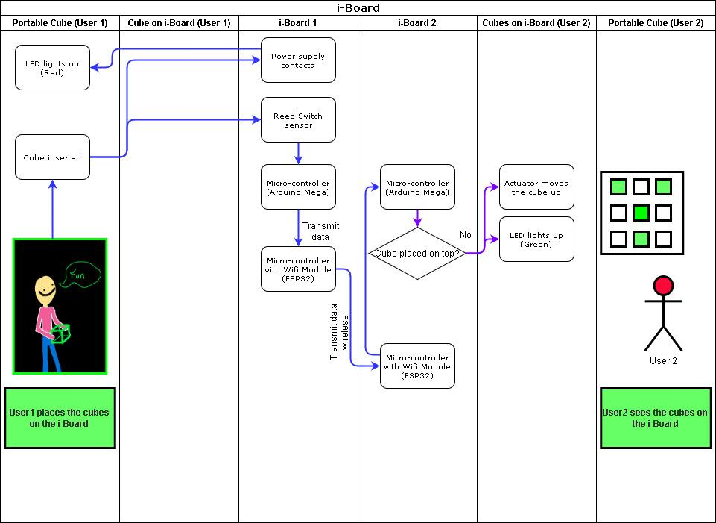
Functional
Diagram
Notes:
Part 1 - Ideal function

Slide 22
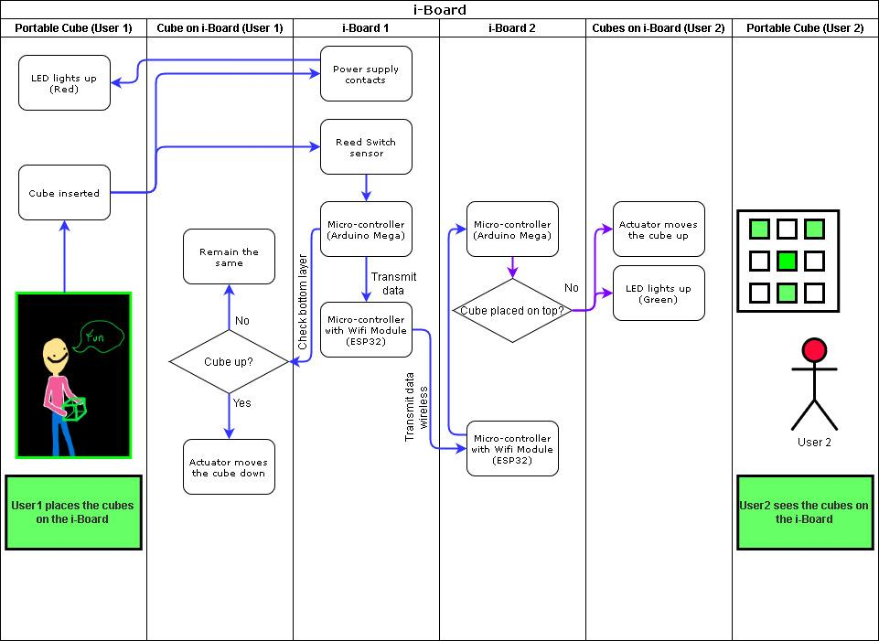
Functional
Diagram
Notes:
Part 2 - What if cubes on User1's i-board are up in bottom layer when placing cubes?

Slide 23
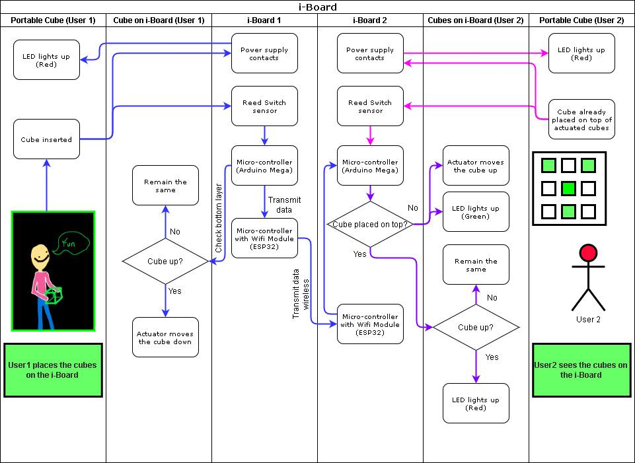
Functional
Diagram
Notes:
Part 3 - What if cubes are up on User 2's i-board?

Slide 24

Functional
Diagram
Notes:
Part 3 - What if cubes are up on User 2's i-board?

Slide 25
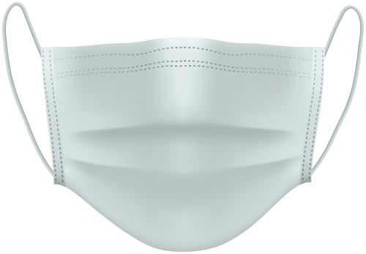
Timeline
Milestone 2
Hardware Choice
Project Implementation
Milestone 3
Final
Presentation
Report
Milestone 1

Slide 26
Timeline
Next steps:
Test single cube (Jan 5)
Software(Algorithms)
Fabricate the entire board
Questions:
Delivery
COVID restrictions

Slide 27
BOM
https://drive.google.com/file/d/1CcIiTmfg8l265j_PUovtmpZodOX2EFgc/view?usp=sharing

Slide 28
Thank You
- Team Hugo

